Slide 1
Deep Fake Image detection using CNN
Team Members
Pavan Kalam
Samran Ali
Satya Machindra
Sreeja Reddy

Slide 2
Introduction
With the emergence of AI systems, it is very difficult to distinguish between the real and AI generated content whether it’s a picture, video, voice note or some text. AI can generate anything
The purpose of this project is to classify between the real and AI generated images.
The best use case is that this project can detect fake or AI generated ID’s by detecting the human faces on them

Slide 3
Methodology
First, we had to include the required python libraries to our python notebook.
Import the Kaggle dataset directly to our notebook with the help of opendatasets library.
Then we will perform data exploration and the analysis on our dataset.
Here we had implemented the sequential layer for the initialization of the model
The first two convolutional layers start with 32 filters, designed to capture low-level features like edges or simple textures.
The filter size is increasing in the next layers to gather more information
The relu activation function introduces non-linearity, helping the model capture more complex patterns.

Slide 4

Methodology
In the MaxPooling layer is used to reduce the size of the feature map to lower the computational load.
In the compile function Adam optimizer is used for adapting the learning rates for each parameter.
The loss function during training used to measure the difference between predicted probabilities and true labels.
The confusion matrix is used to evaluate the the images in both training and validation phases.

Slide 5
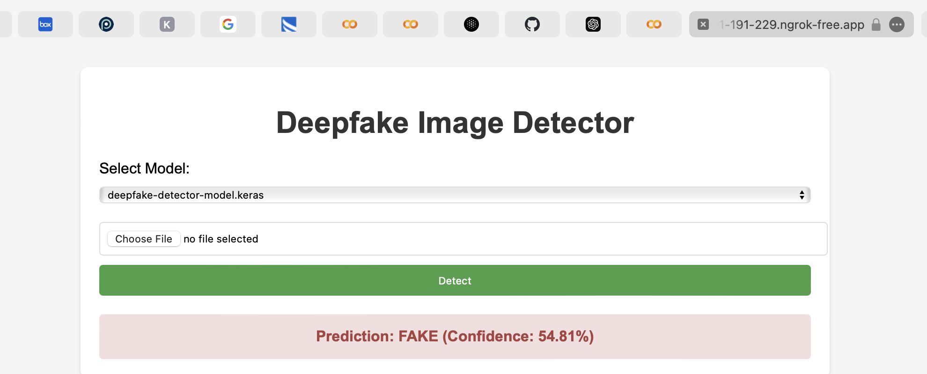
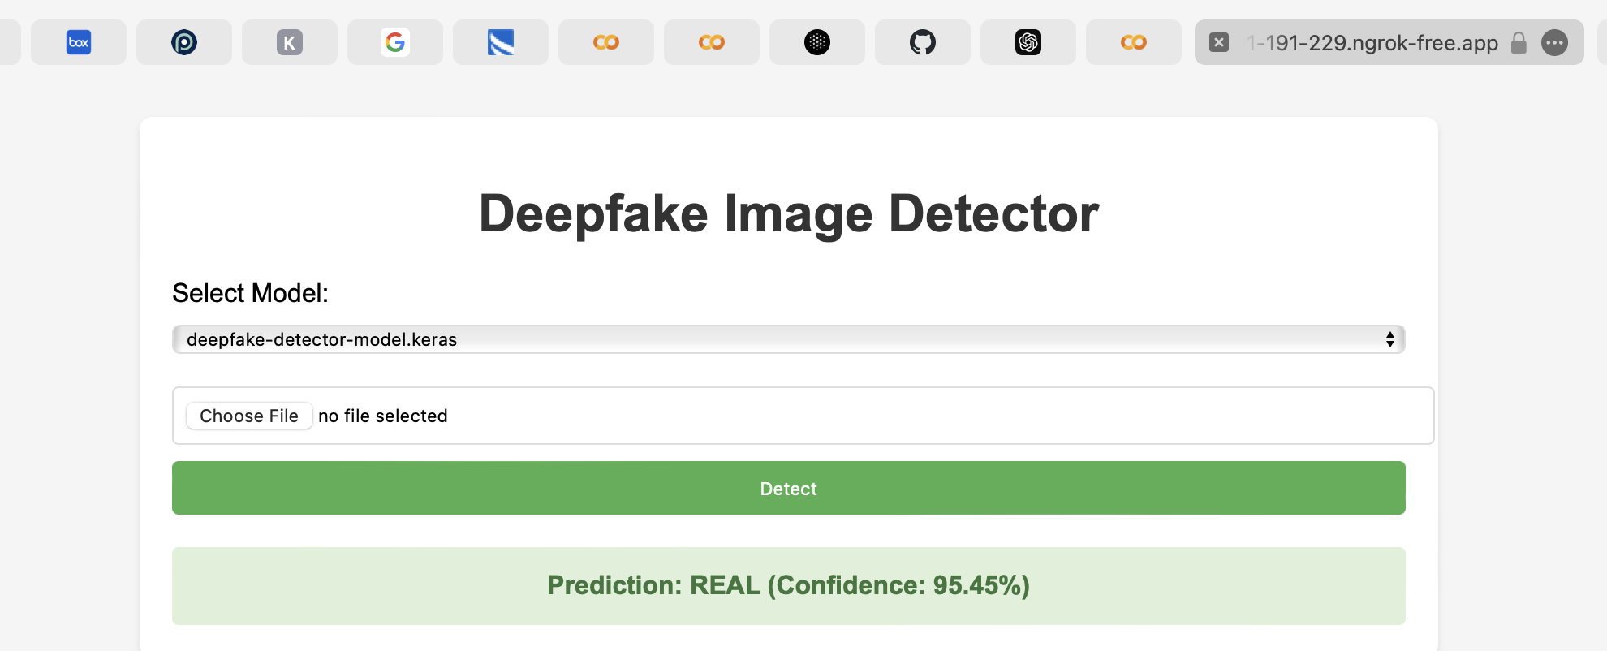
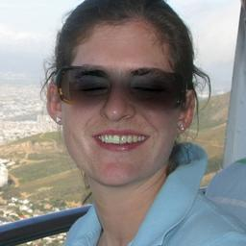
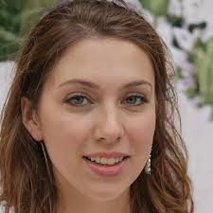
Results
The images fed to the model are of two types: real human captured images and fake AI generated images.

Slide 6

Live Demo
For exploring the live project here, we had included the colab link, https://colab.research.google.com/github/pavan-kalam/Hack-A-Roo-Project-Deep-Fake/blob/main/Hack_A_Roo(Deep_Fake).ipynb

Slide 7
Conclusion
We implemented a convolution neural network to develop a model to detect the AI generated fake images. Also, the results of the model during testing with untrained images was satisfactory.

